Slide 1




Eco-Score
Protecting the Environment for the Future!
Team 404

Slide 2


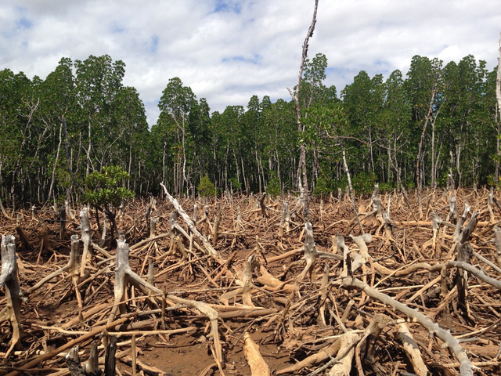
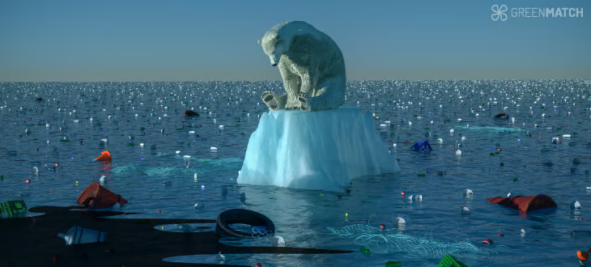
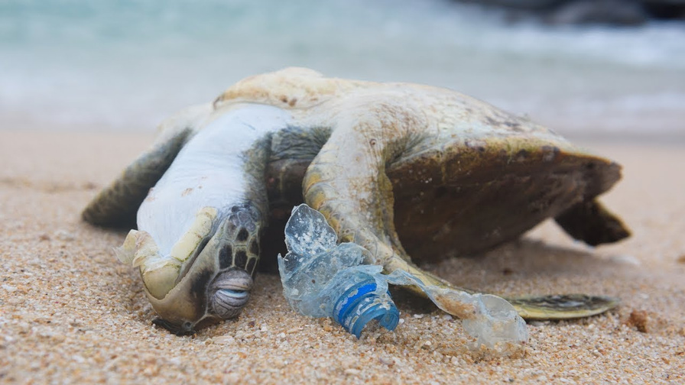



The importance of protecting the environment

Slide 3




Companies pollution aspects
CO2
Water
Energy
Import
Industrial CO2 output drives climate change and air pollution.
Heavy water use strains local resources and ecosystems.
High energy demand increases emissions and environmental impact.
Long-distance imports raise pollution and carbon footprint.

Slide 4

?
?
?
?
?
?
?
?
?
?
?
?
?

Slide 5




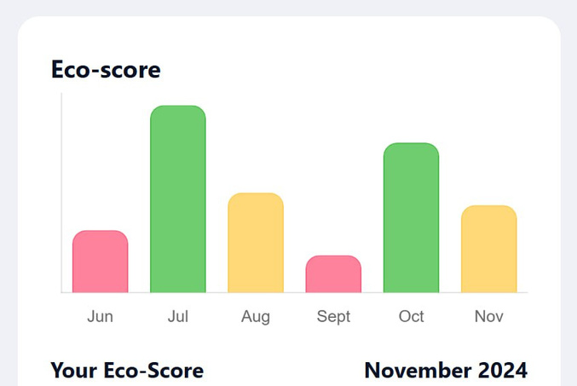
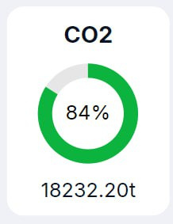
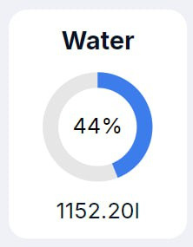
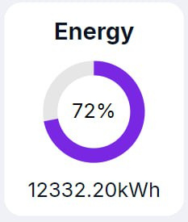
Our solution
01
Action’s analysis
02
Insights
03
Choice’s analysis
04
Recomendations

Slide 6


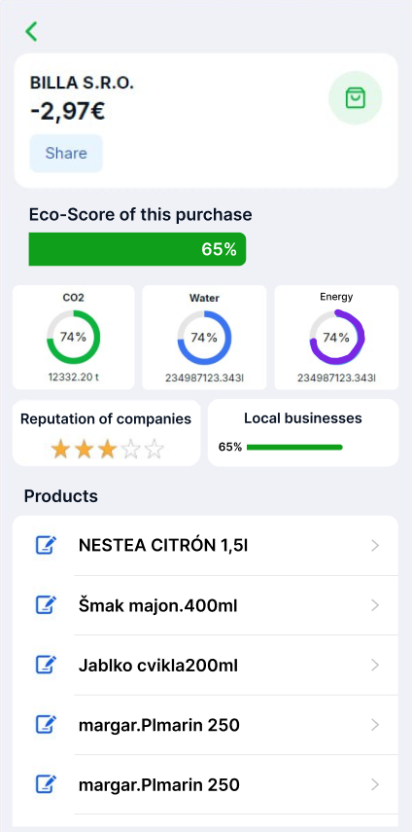
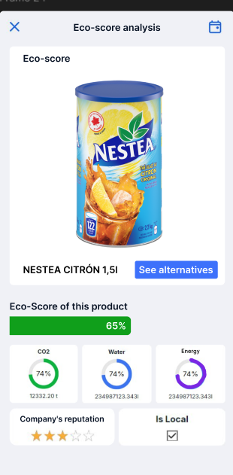

Slide 7
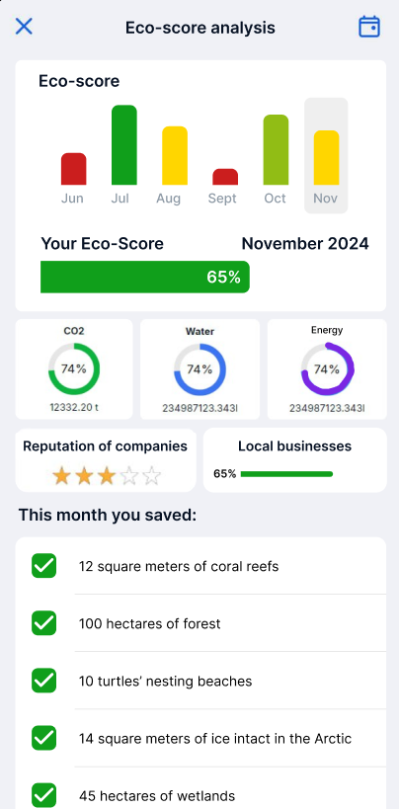





Your scores
Your help
matter

Slide 8

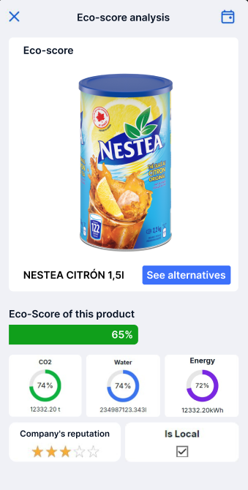
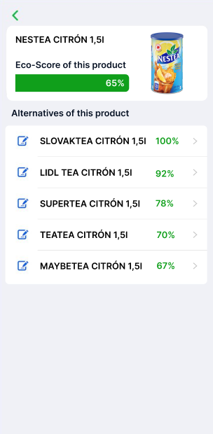
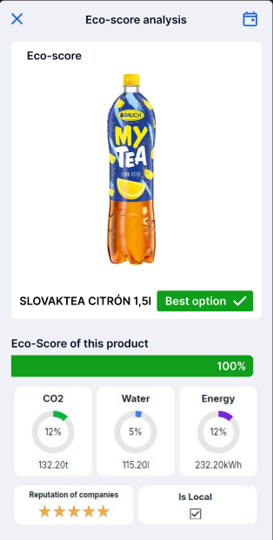
Feature

Slide 9


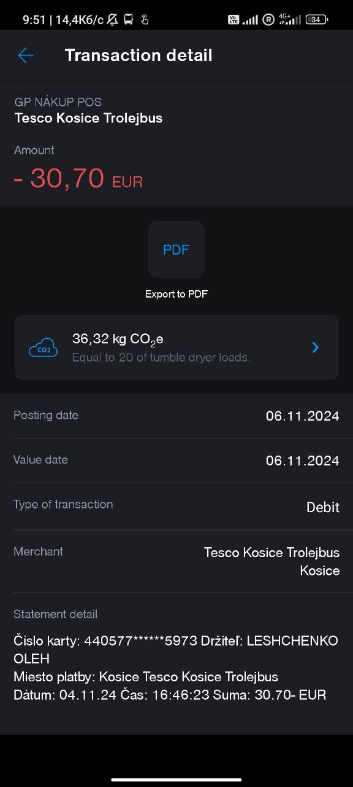
Existing solutions
Algorithm?
All products taken as equal?
Calculated by price?

Slide 10


Thank You
MAKE
IT
MATTER

